Slide 1
ACPM’s COVID-19 Vaccine
Public Relations Effort

Slide 2
What Do We Want to Accomplish
Boost confidence in vaccines and trust in science to influence action across populations
Replace misinformation and confusion with vaccine facts leveraging the expert voice of the preventive medicine profession
Create surround sound of vaccine-positive visibility nationally, regionally and in local markets

Slide 3
Strategic Approach
We Need a Campaign That…
Provides a clear and concise call-to-action that resonates with and motivates target audiences
Delivers compelling campaign content and visuals that underscores importance of vaccines and offers an opportunity to act
Leverages preventive medicine expertise in prevention, research and vaccinations
Mobilizes the preventive medicine professional as credible voice at the local, regional and national level
Fills a critical gap in broader vaccine dialogue while building multiple touch points and moments in time for education
Remains responsive and able to pivot as COVID-19 and the pathway to vaccination evolves

Slide 4
Campaign Platform
Why it Works:
Communicates the profession’s confidence proposition clearly
Allows opportunity to educate about the profession as experts and trusted voice on vaccines
Delivers both assurance in vaccines and acts as an invitation to help instill confidence in those less assured (source of evidence-based information; comes from position of empathy and understanding)
Communicates on multiple levels. It’s a…
Defining quality (what you are)
Value (what you believe in)
Response to anxiety and fear (contrasting viewpoint)
Call to Action (we all can be vaccine confident)
Unifying and resonating rally cry

Slide 5
Vaccine Confident Campaign Messages
American College of Preventive Medicine launched the Vaccine Confident campaign to create a dialogue with preventive medicine experts about why they are confident in the science behind vaccines and their effectiveness, ultimately bolstering consumer assurance in making the decision for themselves and loved ones to get vaccinated.
Preventive medicine professionals are specially trained at the intersection of public health and clinical outcomes and want to add voice to help others understand that vaccines are safe, effective and critical to health – especially now.
Developed from sound science and backed by evidence-based research, vaccines are considered one of the most successful advancements for improving health on a global scale and a key way out of the biggest health crisis of the century.
As a result of COVID-19 concerns, routine vaccinations are at record lows, leaving millions of Americans at risk of long-term health impacts from diseases previously eradicated.
Not taking advantage of proven vaccines turns back the clock on prevention to the 20th century.
Visit VaccineConfident.org to find out why you can be confident.

Slide 6
How Can You Help?
Share why you are vaccine confident at
WORK
HOME
SOCIAL
COMMUNITY
Notes:
KF

Slide 7
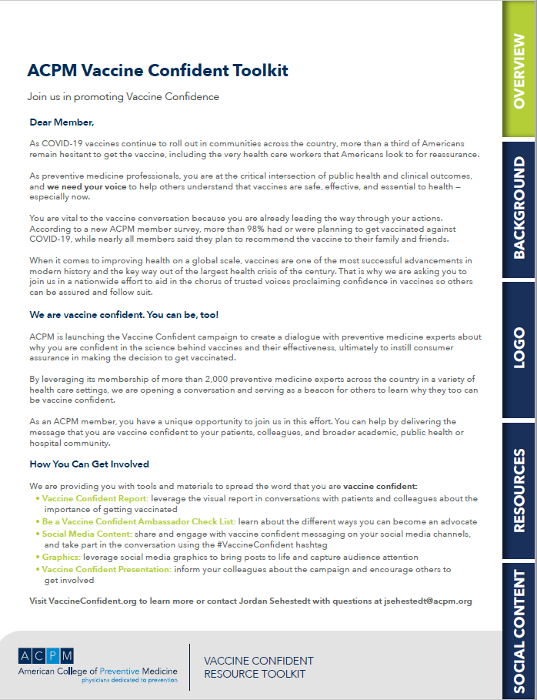
Ways to Share
Vaccine Confident Interactive Member Toolkit
Notes:
KF – update with homepage from interactive

Slide 8
Vaccine Confident Toolkit: Campaign Background
Fact Sheet
Bring awareness to the campaign by
distributing the fact sheet to patients,
colleagues, and broader hospital/health
care community.
Talking Points
Leverage talking points for media
interviews, speaking engagements
and refer to as background for written
communications opportunities
Notes:
KF – update with specifics on what’s in the toolkit and how to use them

Slide 9
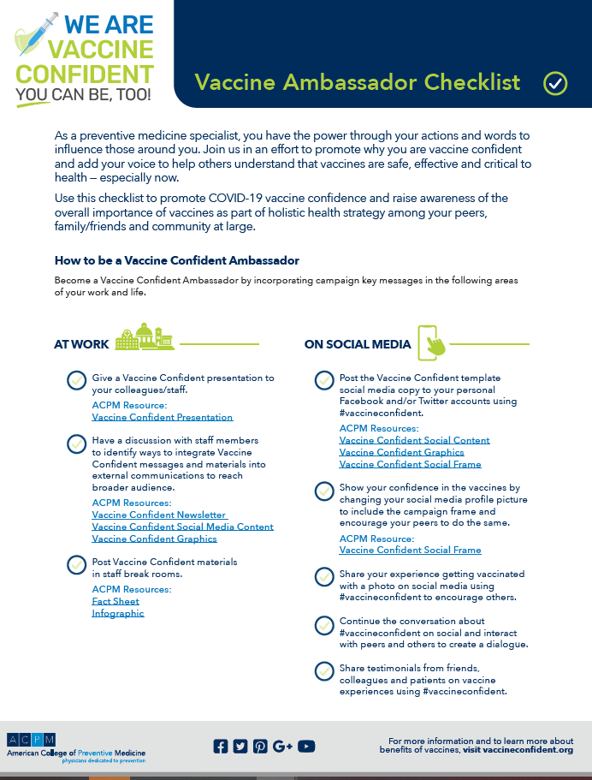
Vaccine Confident Toolkit: Campaign Resources
Ambassador Checklist
Use this checklist to promote COVID-19 vaccine confidence and raise awareness of the overall importance of vaccines as part of a holistic health strategy among your peers, family/friends and community.
Infographic
Download infographic to use as educational
visual on social platforms or in conversations with patients and colleagues.
Presentation Slides
Include in your speaking engagements to discuss importance of being vaccine confident.

Slide 10
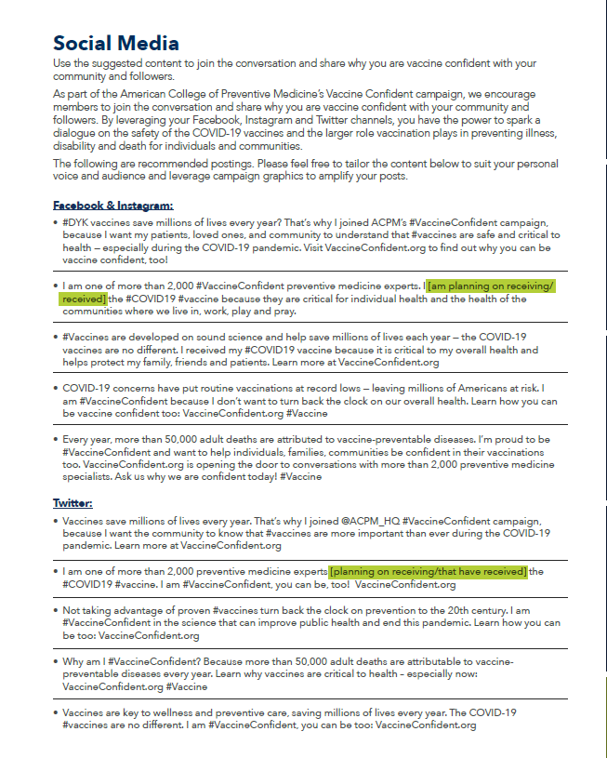
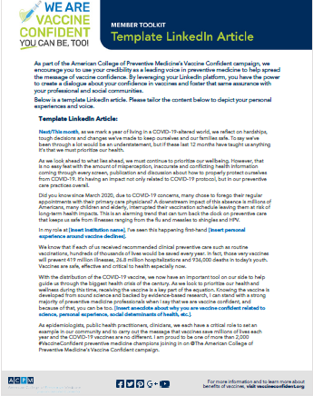
Vaccine Confident Toolkit: Social Media Content
LinkedIn Article
Tailor the template article to lend your voice and create a dialogue about your confidence in vaccines and foster that same assurance with your professional and social communities.
Facebook/Instagram/Twitter Copy
Use the suggested content to join the conversation and share why you are vaccine confident with your
community and followers.

Slide 11
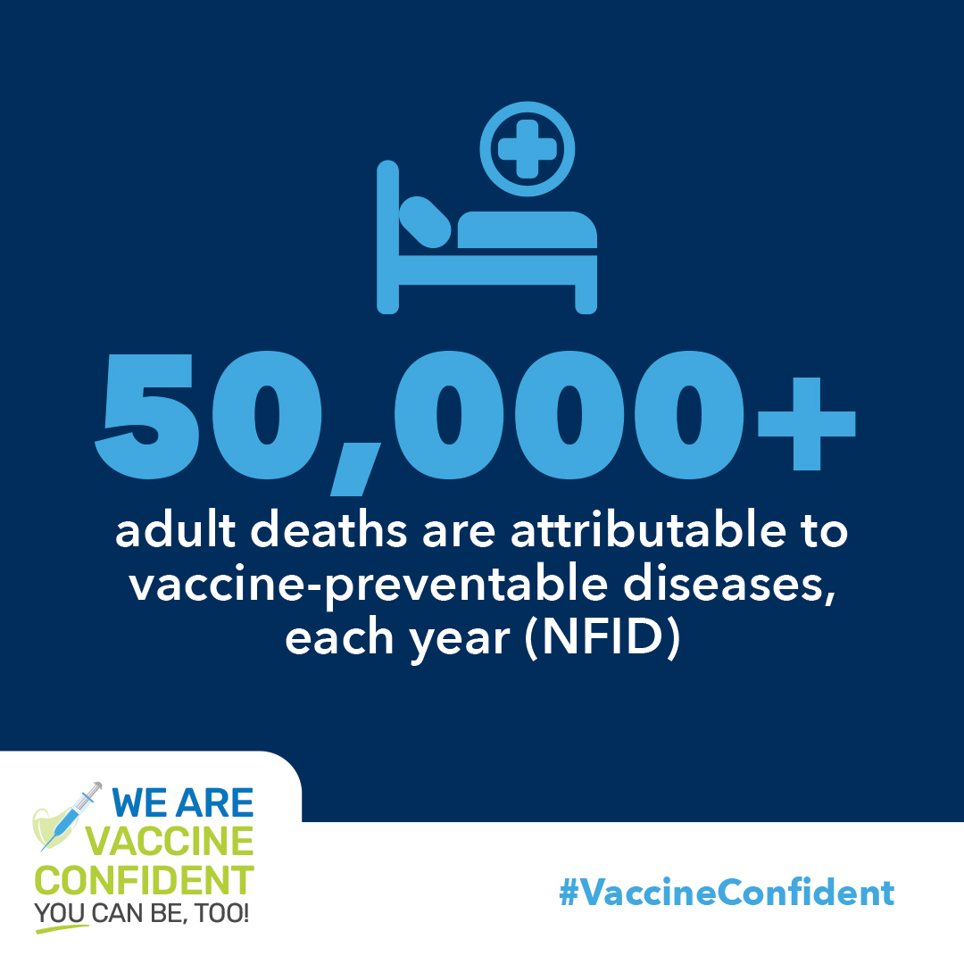
Vaccine Confident Toolkit: Social Media Graphics
Facebook Profile Picture Frame

Slide 12
Vaccine Confident Toolkit: Animated Social Media Graphics

Slide 13
Putting the Toolkit to Work
Communications Training

Slide 14
Communications Training Overview
Storytelling
Media Opportunities
Social Media Best Practices
Sharing the Message
Notes:
SM

Slide 15
Storytelling

Slide 16
“Stories are the most powerful form of human communication.”
— Peg C. Neuhauser, author, Corporate Legends and Lore
Notes:
SM

Slide 17
What’s in a Good Story?
Entertaining: Engaged and interested in what’s coming next
Educational: Spark curiosity and provide something new
Universal: Relatable and tap into emotions and experiences
Organized: Follow cohesive flow to convey core message
Memorable: Through inspiration, humor, or shock - stories stick in the reader’s mind
Purpose: Evokes a reason or action from the audience

Slide 18
Storytelling Essentials
Audience
Core Message
Type of Story
Call to Action
Who cares?
Who will benefit?
Who will take action?
What is the point?
How would you explain in one sentence?
Success Story
Personal/
Human
Educate/
Inform
What do you want them to do?
Medium
Written
Video
Audio
Spoken

Slide 19
Using the Right Voices
Know who has the authority to tell the story
authority
diversity
Use diverse voices and backgrounds
relevance
Select relevance over popularity or title when considering who to feature in stories
relatable
variety
Showcase relatable stories relevant to your unique cause and local area
Look for different points of view (success stories, warning stories, future-forward)

Slide 20
Telling Your Story in 60 Seconds (more or less)
THE HOOK
(10-15 seconds)
Who you are
THE BODY
(30-60 seconds)
Prevention differentiators
THE CLOSE
(15-30 seconds)
What can you do
Value of what you do
The impact you make
Impact stories
Effectiveness of prevention
Notes:
SM:
Step 1: How to you tell your story
Step 2: Example of how it works: Bringing to life using Vaccine Confident content

Slide 21
Making the Most of Media Opportunities

Slide 22
Take Advantage of the Moment
Proactive and Reactive Media Opportunities
Being Prepared
Interview Best Practices & Techniques
Amplify Your Coverage
Examples

Slide 23
Proactive Media Opportunities
What is it?
How do you do it?
What kinds of outlets?
Contact reporters directly: short email pitch (use your elevator story!)
Send contributed article: byline/opinion piece (see toolkit for LinkedIn template)
TV broadcast stations
Radio shows
Newspapers
Local blogs
You create the news

Slide 24
Reactive Media Opportunities
What is it?
What to consider?
Can you get questions in advance
Can you offer an alternative perspective
Do your research on outlet/reporter to get a sense of understanding of issue/if there is a slant
Media contacts you for commentary
You are reacting to existing news

Slide 25
Before You Get Started: How to Prepare for Interviews
Know Your Messaging
Put messaging into your own words to convey answers and broaden response
Be Flexible
News can shift in the blink of an eye
KISS
“Keep it short and simple”. Be sure to speak slowly and clearly.
Redirect Discrepancies
Turn “negatives” into “positives” and politely correct inaccuracies or false statements
1
3
5
7
2
4
6
Be Prepared
Organize thoughts and prepare potential answers ahead of interview. Simplify to top three messages
Get Familiar
Look at other interviews done by the reporter
Read through any pre-interview materials
Communicate Facts
Be open and avoid guessing

Slide 26
Consider the Platform
BY PHONE
ON CAMERA
Short-Hand
Have notes on hand
Organize in quick, easy to read bullets
Location, location, location
Find a quiet place
Take it away from computer or other distractions
Dress for Success
Wear something comfortable; consider wearing your white coat
Stay away from white, black, stripes and patterned clothing
Remove jewelry that could make noise or interfere with mics
Be mindful of headphones
Location, location, location
Check background and lighting (consider the time of day for lighting)
Notes:
KF

Slide 27
During the Interview
Keep It Newsworthy and Relevant
Plug key statistics and important facts
Consider real-life examples to make story relevant
Be Concise
A 10-minute interview may end up as a blurb or short sound bite
Express your thoughts in a few hard-hitting sentences
Don’t overload the reporter with numbers
Limit jargon (does it pass the grandmother test?)
Pay Attention to How You Say It
Emotion, or lack of it, will come across on camera
Notes:
KF

Slide 28
Staying On-Message
Flagging
This technique draws attention to what you are about to say.
“What I hear most from my patients is…”
“If people remember nothing else, people should…”
“I think it all boils down to…”
“What's most important is...”
Bridging
Helps move from one issue to another, and bridge the focus back to your key messages
“I don’t know the specifics, but I do know that…”
"I don't know the answer to that question. But what I do know is...“
"Historically, that was the case. But today, here's what we're doing...“
"No, but let me explain..."
Blocking
If a reporter persists with questions you can’t answer, defer him or her to the ACPM Vaccine Confident website for more information.

Slide 29
Social Media Primer

Slide 30
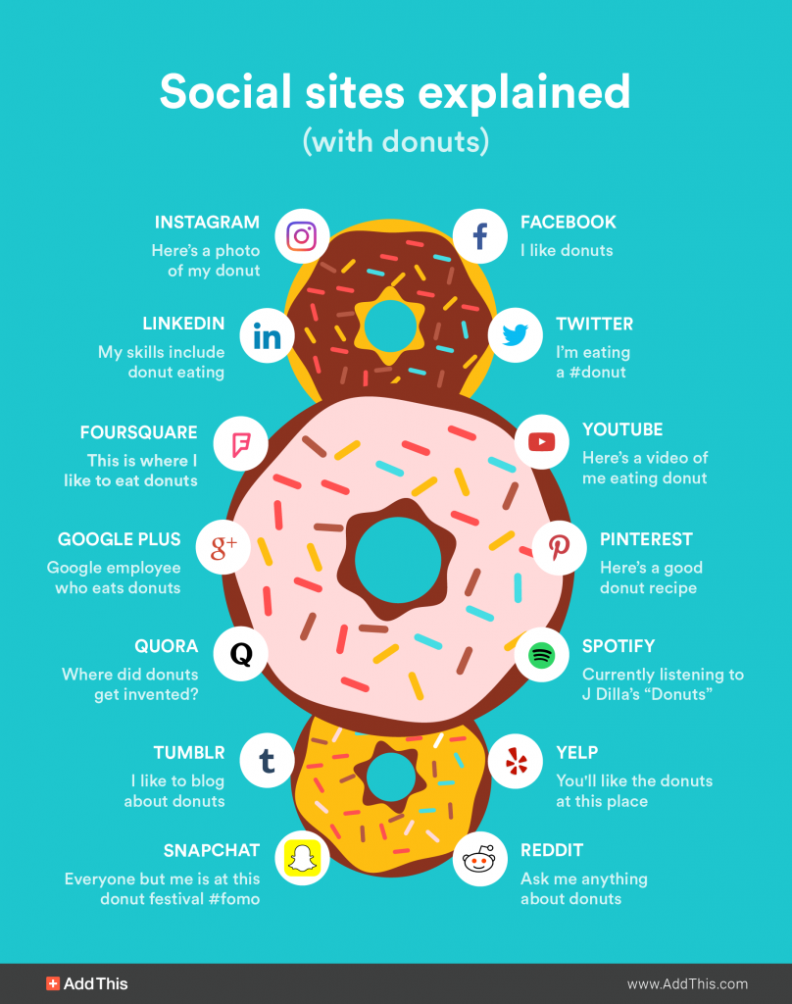
Social Media Explained (*with donuts*)
Tik Tok
Here’s a video of how to make donuts
Notes:
Overwhelming – good illustration on how to use different channels

Slide 31
Focus on the Core Four

Slide 32
Social Media is Key to Support
2.2 billion
active users
per month
4.2 billion ”likes” per day
800 million tweets sent
each day
760 million active users
as of December 2020
Notes:
Switch to LinkedIn from TikTok

Slide 33
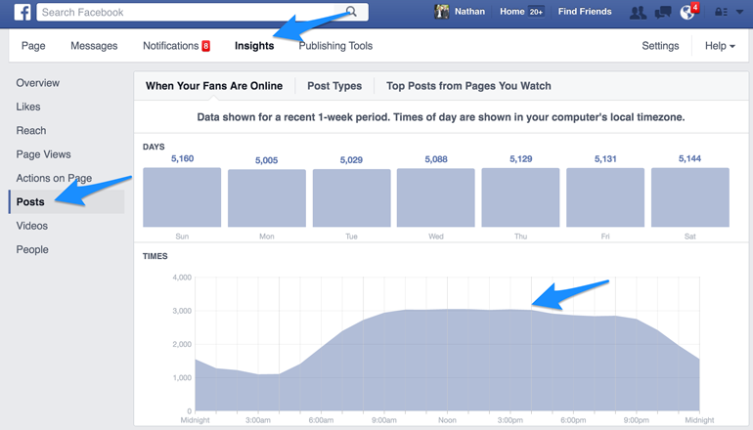
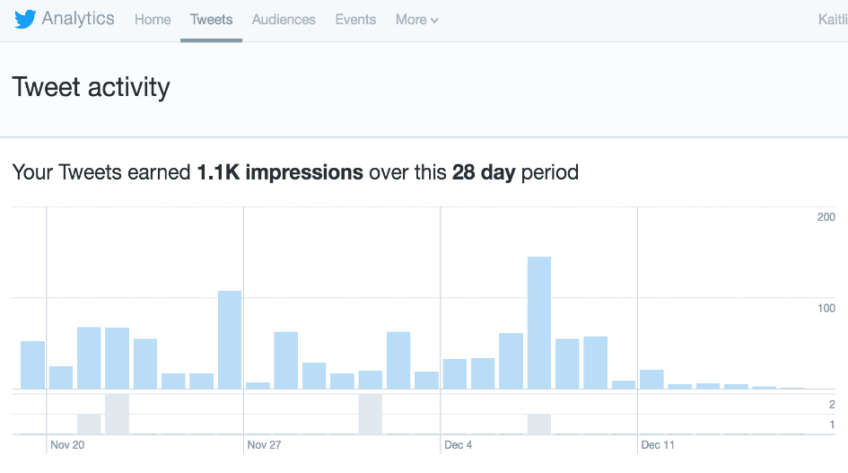
Timing is Everything!
Twitter | 12-3 PM | Weekdays
Facebook | 1-4 PM | Late-Week
Instagram | 5-6 PM | Mid-Week
LinkedIn | 5-7 PM | Weekdays especially Mondays
Pinterest | 8-11 PM | Saturday

Slide 34
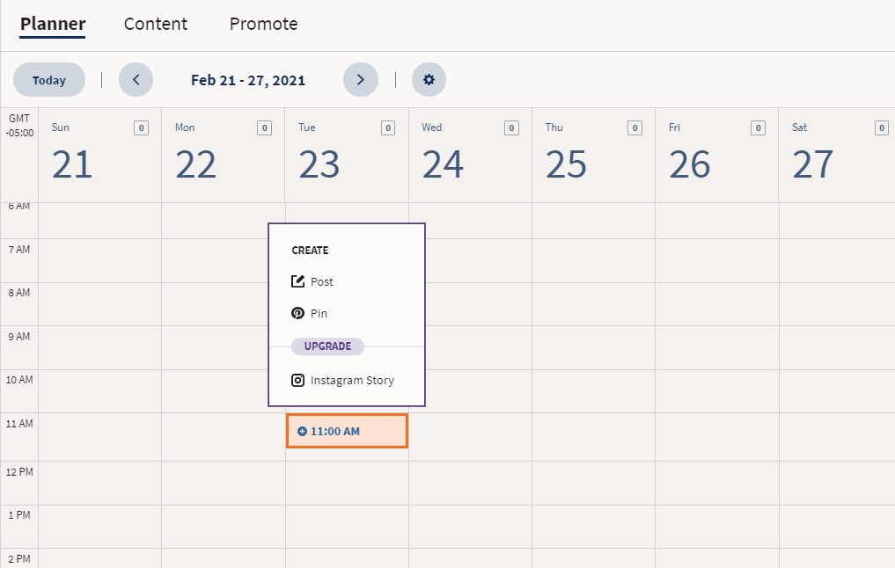
There’s an App for That!
Save on time by using social media management tools
Preschedule posts
Curate content from all social media platforms
Identify trending content
Helpful Tools
Hootsuite (free)
Buffer (free/small fee)
Post Planner (small fee)
Monday.com (small fee)
Notes:
we’re going to give you social content and within one sitting you can schedule all at once

Slide 35
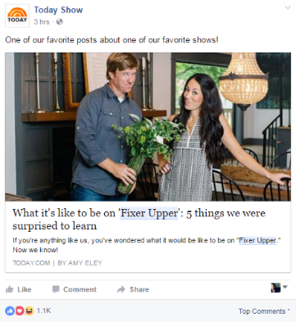
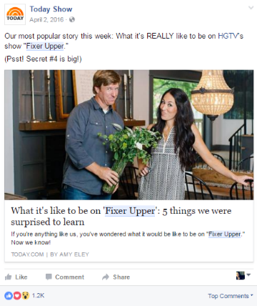
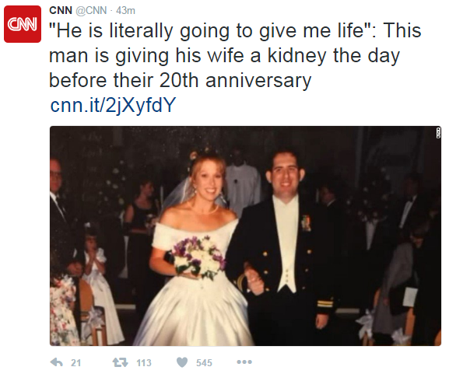
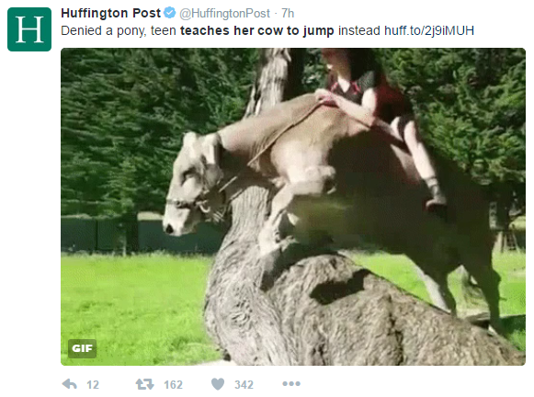
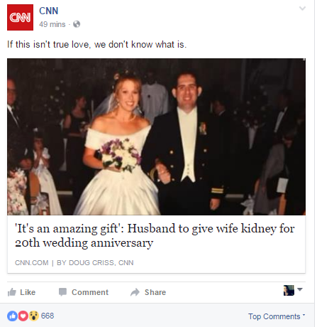
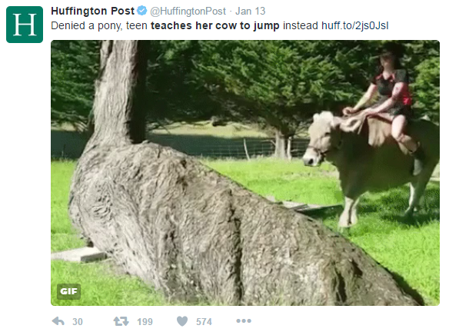
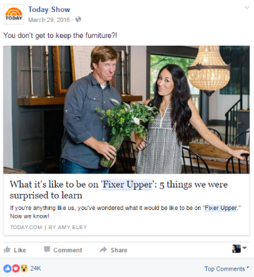
Content Options
Repurpose
Take one piece of content and develop multiple messages
Resurface
Share a post again during a different moment in time (3+ months)
Refresh
Use a favorite post and give it new life with new text

Slide 36
#Creation #Tracking #What
Whatsthebigdeal?
Why are hashtags important?
Clickable
Searchable
Trackable
Extend your reach
Be Strategic: You only have a limited amount of time and space to make an impact and catch others eyes, use hashtags that carry your core message
#VaccineConfident
What Works Best?
Facebook: 2-3
Twitter: 1-2
LinkedIn: 3-5
Instagram: 1-2*
*Allows for up to 30 hashtags BUT if you use more than 2 in your post consider including any additional as a comment

Slide 37
Dealing With Trolls
What is a “Troll”?
An internet troll is someone who purposely says something
controversial or uncalled for in order to get a rise out of other users.
How to Handle a Troll:
Ignore, Don’t Fuel – Many internet trolls want a reaction from
whomever they are after. If you ignore them, they will often wind down.
Respond with Facts – If someone is spreading rumors or inaccurate information, respond to them politely with real facts.
Block User – Most internet trolls are usually harmless, however, if using hate speech, report them to the social network and then block them from your platform.
Correct Mistakes – Let your audience know you are aware of the mistake and you have taken steps to correct it.
Be Polite – It is important to respond as it will help you connect to the user, but be polite as it will hopefully prompt a respectable conversation rather than develop a troll on your page.

Slide 38
Amplify Message Through Events

Slide 39
What’s an Event Anymore?
Any opportunity to gather a group to hear your message
Staff meeting
Briefing with stakeholders (NGOs, investors, BOD)
Virtual speaking events
Professional groups
Town halls
Hill day with elected officials
Key Considerations
Can you incorporate Vaccine Confident messages into existing speaking obligations?
Is there an opportunity to offer to be a speaker to promote Vaccine Confident message?
Use visuals to better tell the Vaccine Confident story (PPT template)

Slide 40
Reaching Key Audiences
Regardless of what your event looks like, use it as a moment to connect with your audience (peer-to-peer or consumer)
Elements to Strengthen Your Event
Don’t go it alone
Engage with your peers and ACPM members
Identify new influencers who offer unique but complementary perspective on issue (faith-based orgs, local businesses, media personalities)
Invite elected official
Get the word out
Media materials (press release or media advisory)
Print/online materials (flyers, newsletters, banners)
Employer outlets (newsletters, website, email blasts)

Slide 41
Event Cadence
Before
During
After
Organization/Member Communications
Listservs
Newsletters
Emails to Leadership
Social Media and Digital Channels
Promote using #VaccineConfident
Publish on org. event page
Local Media Outreach
Press release/media advisory
Submit an op-ed to your local paper
Invitations to Local Officials
Contact scheduler
Engage early and include as much detail as possible
Invite to Attend
Speaking Role
If creating your own event, secure spokesperson in advance and facilitate virtual media interviews
Share #VaccineConfident visuals with attendees to use during the event
Live Tweet/Post on social media
Use images secured during event (screenshots) to share with local photo desks post-event
Send broadcast “Reader” to local TV stations
Post-event social media content
Quotes, video clips
Follow up with attendees

Slide 42
Questions & Discussion

