Slide 1


Guiding your hypertension improvement journey:
A practical approach for busy healthcare teams engaged in quality improvement work
Brant J. Oliver, PhD, MS, MPH, FNP-BC, PMHNP-BC
Principal Scientist (Healthcare Improvement Science), Dartmouth-Hitchcock Health, Lebanon, NH
Associate Professor, The Dartmouth Institute and Geisel School of Medicine at Dartmouth, Hanover, NH
Faculty Senior Scholar, Veterans Affairs HPEER and VAQS National Fellowship Programs
Director, Chronic Health Improvement Research Program
CHRONIC HEALTH IMPROVEMENT RESEARCH PROGRAM

Slide 2
Disclosure Statement
No real or perceived conflicts to disclose.
CHRONIC HEALTH IMPROVEMENT RESEARCH PROGRAM

Slide 3
Learning Objectives
After completing this learning activity, participants will be able to:
1) describe a basic approach to building and organizing an improvement effort using the "Improvement Passport" approach;
2) discuss the use of various improvement tools to help facilitate your improvement work; and
3) technically interpret run charts and advise improvement efforts based on run chart analyses.
CHRONIC HEALTH IMPROVEMENT RESEARCH PROGRAM

Slide 4
Acknowledgments
The Dartmouth Institute (TDI)
VA National Quality Scholars Fellowship (VAQS)
Institute for Healthcare Improvement Open School (IHI)
CHRONIC HEALTH IMPROVEMENT RESEARCH PROGRAM

Slide 5


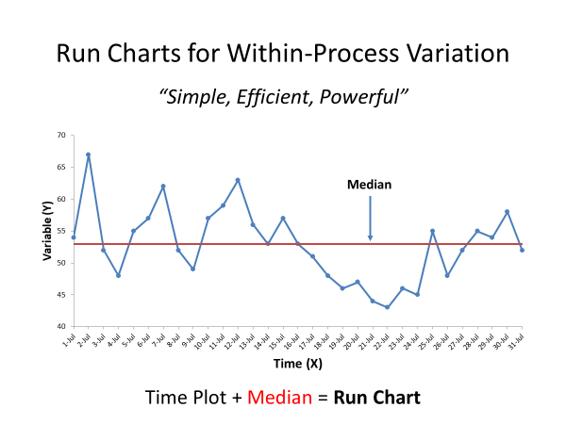
Agenda
Part I
Improvement Passport
Part II
Improvement Toolbox
Part III
Improvement Measurement
CHRONIC HEALTH IMPROVEMENT RESEARCH PROGRAM

Slide 6
Part I: The Improvement Passport
Purpose and Rationale
Context and Population
Aims
Measurement Definitions
Data Collection Plan
Tests of Change
Data Analysis
Your Passport can be a simple slide set with 7 slides, each addressing one of the 7 core domains…
CHRONIC HEALTH IMPROVEMENT RESEARCH PROGRAM

Slide 7
Part I: The Improvement Passport
Purpose and Rationale: What is the objective and focus of your work? Why is it important to do this work now?
Context and Population
Aims
Measurement Definitions
Data Collection Plan
Tests of Change
Data Analysis
SQUIRE 2.0 Format Rationale Statement Template: “IF… THEN … SO THAT … SO THAT…”
Example: “If we can better understand drivers of uncontrolled HTN management in African American Men, then we can address these drivers to improve HTN for them, so that they will achieve improved HTN control, so that they can achieve better overall cardiovascular and general health outcomes.”
CHRONIC HEALTH IMPROVEMENT RESEARCH PROGRAM
http://www.squire-statement.org/

Slide 8
Part I: The Improvement Passport
Purpose and Rationale
Context and Population: What are the characteristics of your setting. Who are the people you are trying to help?
Aims
Measurement Definitions
Data Collection Plan
Tests of Change
Data Analysis
Describe your “5Ps”*
  Purpose
  People (Patients)
  Professionals
  Processes (Process Maps-see Toolbox)
  Patterns
Create a process map (see Toolbox)
CHRONIC HEALTH IMPROVEMENT RESEARCH PROGRAM
*www.clinicalmicrosystem.org

Slide 9
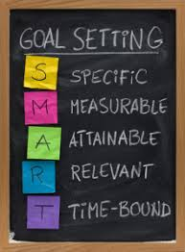
Part I: The Improvement Passport
Purpose and Rationale
Context and Population: What are the characteristics of your setting. Who are the people you are trying to help?
Aims: What will you improve (goal), and by when?
Measurement Definitions
Data Collection Plan
Tests of Change
Data Analysis
Aim Statement Template: “We aim to improve ______(target)_____ from _________(current baseline)_______ to ___________(goal)________ by __________(date)_______________.”
Example: “We aim to improve monthly HTN monitoring follow up adherence rate from current baseline of 35% to initial goal of 75% by May 1, 2021.”
Other Aim Statement Templates (see Toolbox)
IHI Aim Statement Worksheet
Clinical Microsystems Global Aim Statement Template
Clinical Microsystems Specific Aim Template
CHRONIC HEALTH IMPROVEMENT RESEARCH PROGRAM

Slide 10
Part I: The Improvement Passport
Purpose and Rationale
Context and Population: What are the characteristics of your setting. Who are the people you are trying to help?
Aims
Measurement Definitions: How will you know that a change is an improvement? Define your measures and link to aims.
Data Collection Plan
Tests of Change
Data Analysis
Define your measures:
  Conceptual Definition
  Operational Definition
  Link to Aims
Tools:
  Definitions “Inverted Triangle” worksheet
  Modified Driver Diagram
“Clean Room Exercise” – improvement measures are context specific!
  Hospital Operating Suite
  Teenager’s Bedroom
Operationally Define: “Clean”
CHRONIC HEALTH IMPROVEMENT RESEARCH PROGRAM

Slide 11
Part I: The Improvement Passport
Purpose and Rationale
Context and Population: What are the characteristics of your setting. Who are the people you are trying to help?
Aims
Measurement Definitions
Data Collection Plan: Describe the “who, what, where, when, and how.”
Tests of Change
Data Analysis
Describe the 5 Elements for Data Fidelity:
  What data will be collected?
  Who will collect and manage the data?
  Where will the data be collected (setting)?
  When will the data be collected (sampling frame)?
  How will the data be collected and validated?
Tools (see Toolbox)
  Data Collection Plan Worksheet
  Modified Driver Diagram
CHRONIC HEALTH IMPROVEMENT RESEARCH PROGRAM

Slide 12
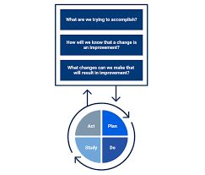
Part I: The Improvement Passport
Purpose and Rationale
Context and Population: What are the characteristics of your setting. Who are the people you are trying to help?
Aims
Measurement Definitions
Data Collection Plan
Tests of Change: What changes (interventions, exposures) will you test? How will you implement and assess them?
Data Analysis
Plan-Do-Study-Act (PDSA) Cycles
  Derived from Scientific Method
  Sequential Small Experiments
  Small scale to start then can scale over time
  Rapid
PDSA Components
  Plan: Strategy and hypothesis for the test of change
  Do: Conduct and assess the test of change
  Study: Analyze and review the results
  Act: “Adopt, Adapt, or Abandon”
Tools (see Toolbox)
  PDSA Worksheet
  Definitions Worksheet
  Modified Driver Diagram
Develop a list of potential “change ideas” related to drivers
  Align with Aims and measures
  Align with process map
  Align with drivers
Develop and conduct PDSA cycles
Tools:
  Definitions Worksheet
  Process map
  Driver diagram
CHRONIC HEALTH IMPROVEMENT RESEARCH PROGRAM
The IHI Model for Improvement. www.ihi.org.

Slide 13
Part I: The Improvement Passport
Purpose and Rationale
Context and Population: What are the characteristics of your setting. Who are the people you are trying to help?
Aims
Measurement Definitions
Data Collection Plan
Tests of Change: What changes (interventions, exposures) will you test? How will you implement and assess them?
Data Analysis: How will you know that a change is an improvement?
Improvement Measurement = Study of Variation (not Inference)
  Great for “small data”
  Real-time capability
  Identifies patterns of variation to inform improvement
  Even simple approaches (Run Charts) can be very effective
Tools:
  Run chart template
  Advising improvement based on assessment of variation algorithm
CHRONIC HEALTH IMPROVEMENT RESEARCH PROGRAM

Slide 14
Part II: The Improvement Toolbox
Process Map
Definitions Worksheet
Data Collection Plan
Driver Diagram
Modified Driver Diagram
PDSA Worksheet
Run chart template
Using variation to inform improvement algorithm
Use these tools to help develop your Improvement Passport and empower and inform your improvement work…
CHRONIC HEALTH IMPROVEMENT RESEARCH PROGRAM

Slide 15
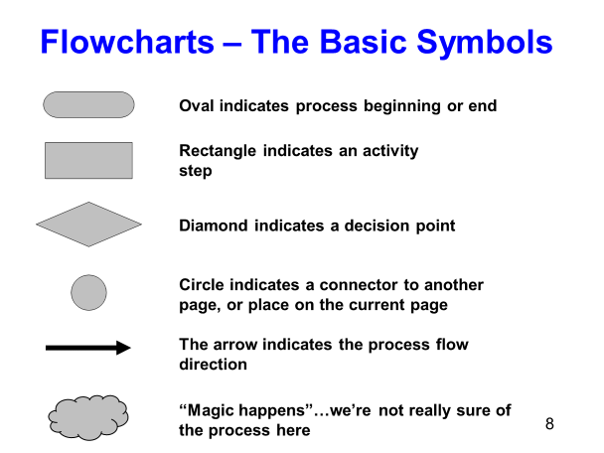
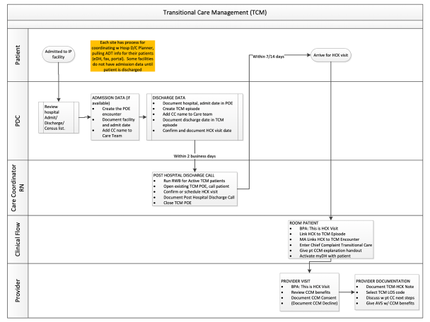
Part II: The Improvement Toolbox
Process Map: Describes the sequence of events in the process of care your population is engaged in.
Definitions Worksheet
Data Collection Plan
Driver Diagram
Modified Driver Diagram
PDSA Worksheet
Run chart template
Software!
Lucid Charts
Visio
PowerPoint (Insert “shapes”)
MS Word (Insert “shapes”)
Others (QI Macros, etc.)
CHRONIC HEALTH IMPROVEMENT RESEARCH PROGRAM

Slide 16
Part II: The Improvement Toolbox
Process Map: Describes the sequence of events in the process of care your population is engaged in.
Definitions Worksheet
Data Collection Plan
Driver Diagram
Modified Driver Diagram
PDSA Worksheet
Run chart template
CHRONIC HEALTH IMPROVEMENT RESEARCH PROGRAM

Slide 17
Part II: The Improvement Toolbox
Process Map: Describes the sequence of events in the process of care your population is engaged in.
Definitions Worksheet
Data Collection Plan
Driver Diagram
Modified Driver Diagram
PDSA Worksheet
Run chart template
CHRONIC HEALTH IMPROVEMENT RESEARCH PROGRAM

Slide 18
Part II: The Improvement Toolbox
Process Map: Describes the sequence of events in the process of care your population is engaged in.
Definitions Worksheet
Data Collection Plan
Driver Diagram
Modified Driver Diagram
PDSA Worksheet
Run chart template
CHRONIC HEALTH IMPROVEMENT RESEARCH PROGRAM
www.ihi.org

Slide 19
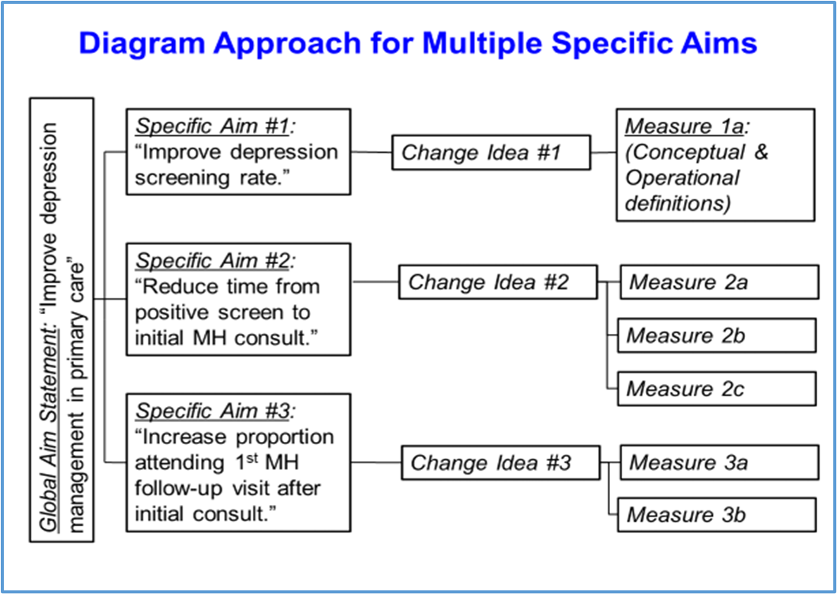
Part II: The Improvement Toolbox
Process Map: Describes the sequence of events in the process of care your population is engaged in.
Definitions Worksheet
Data Collection Plan
Driver Diagram
Modified Driver Diagram
PDSA Worksheet
Run chart template
CHRONIC HEALTH IMPROVEMENT RESEARCH PROGRAM

Slide 20
Part II: The Improvement Toolbox
Process Map: Describes the sequence of events in the process of care your population is engaged in.
Definitions Worksheet
Data Collection Plan
Driver Diagram
Modified Driver Diagram
PDSA Worksheet
Run chart template
CHRONIC HEALTH IMPROVEMENT RESEARCH PROGRAM

Slide 21
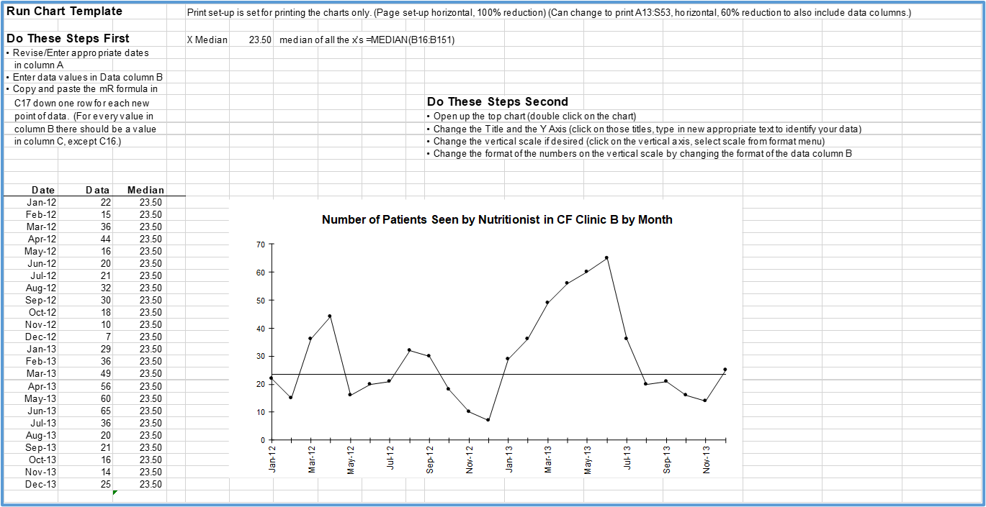
Part II: The Improvement Toolbox
Process Map: Describes the sequence of events in the process of care your population is engaged in.
Definitions Worksheet
Data Collection Plan
Driver Diagram
Modified Driver Diagram
PDSA Worksheet
Run chart template
Software!
Excel templates (see Toolbox)
QI Macros
SPC XL
Minitab
Others
CHRONIC HEALTH IMPROVEMENT RESEARCH PROGRAM

Slide 22
Part III: Improvement Measurement
Types of Measurement
Study of Variation
Using Variation to Inform Improvement
Run Charts
Run Chart Practice!
CHRONIC HEALTH IMPROVEMENT RESEARCH PROGRAM

Slide 23
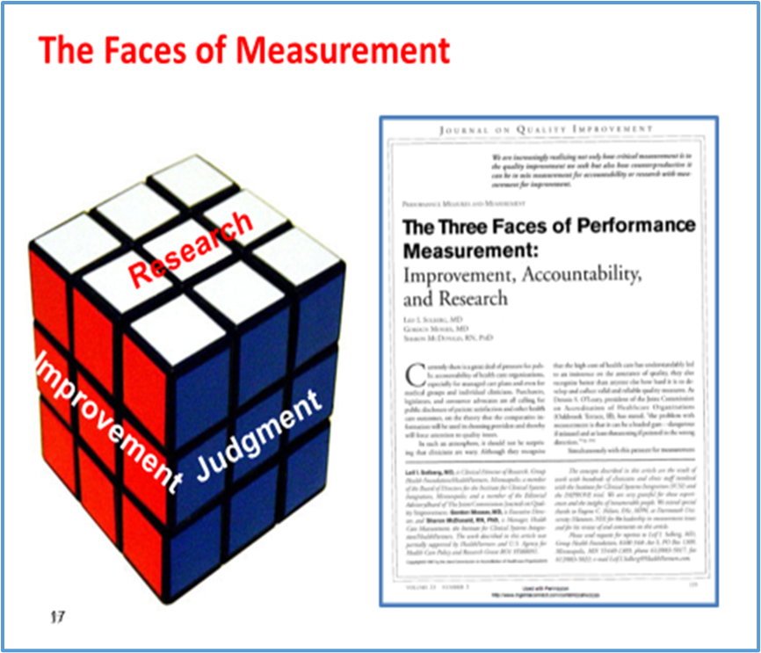
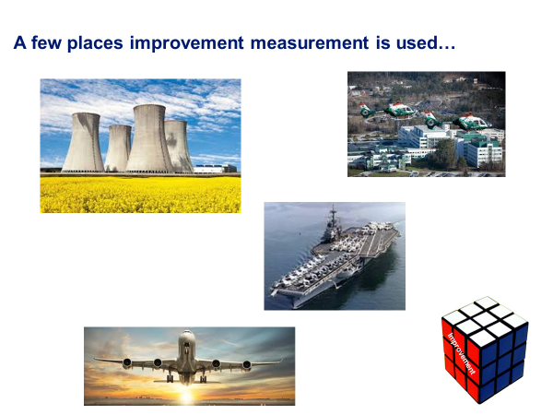
Part III: Improvement Measurement
Types of Measurement
Study of Variation
Using Variation to Inform Improvement
Run Charts
Run Chart Practice!
Three Faces of Improvement Measurement (article)
CHRONIC HEALTH IMPROVEMENT RESEARCH PROGRAM

Slide 24
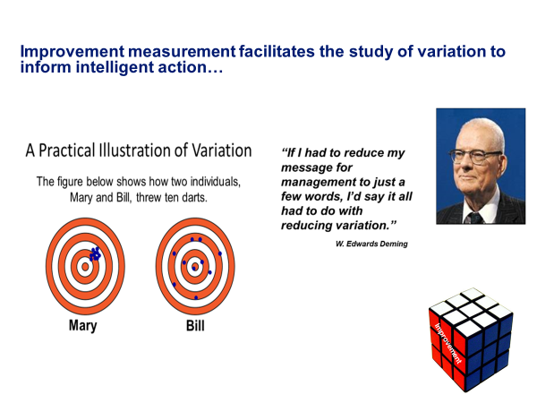
Part III: Improvement Measurement
Types of Measurement
Study of Variation
Using Variation to Inform Improvement
Run Charts
Run Chart Practice!
Precision & Accuracy
CHRONIC HEALTH IMPROVEMENT RESEARCH PROGRAM

Slide 25
Part III: Improvement Measurement
Types of Measurement
Study of Variation
Using Variation to Inform Improvement
Run Charts
Run Chart Practice!
CHRONIC HEALTH IMPROVEMENT RESEARCH PROGRAM

Slide 26
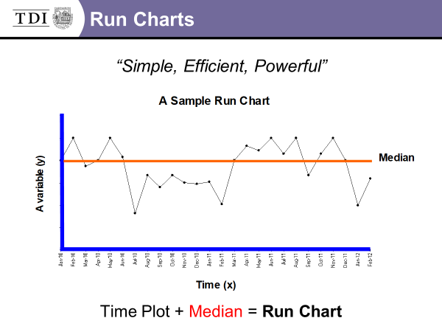
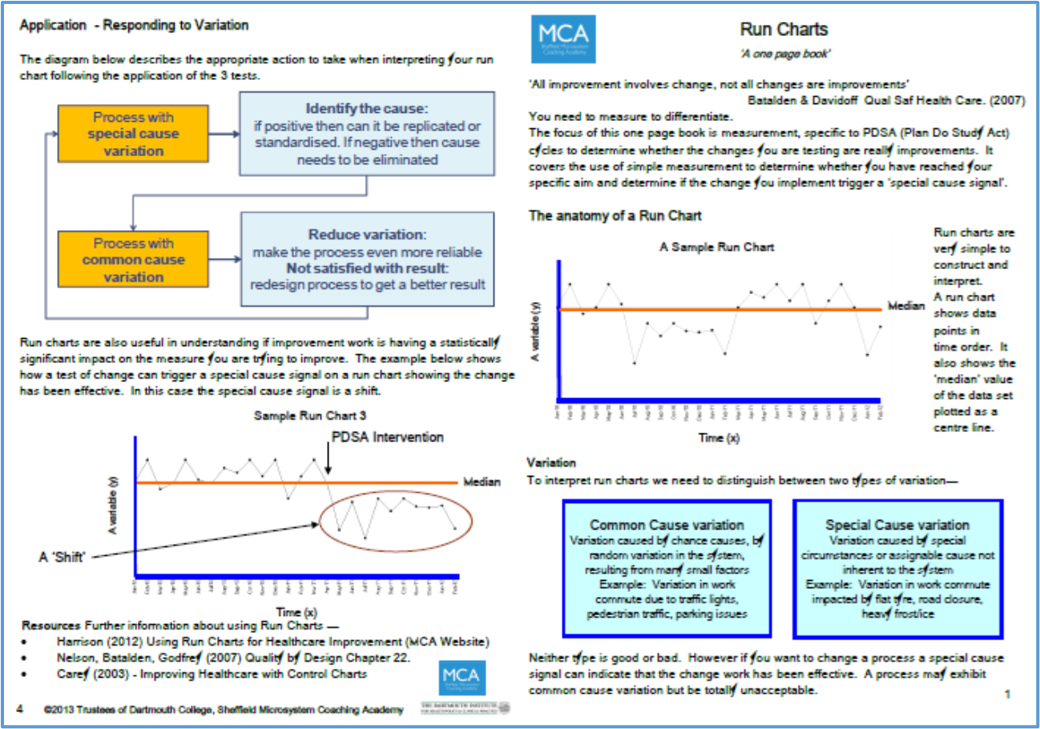
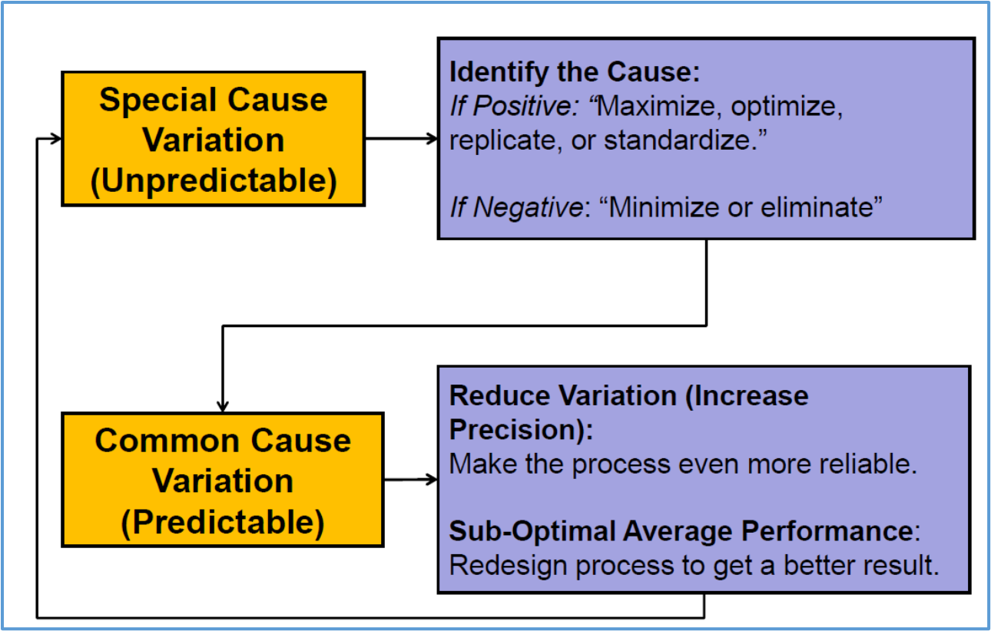
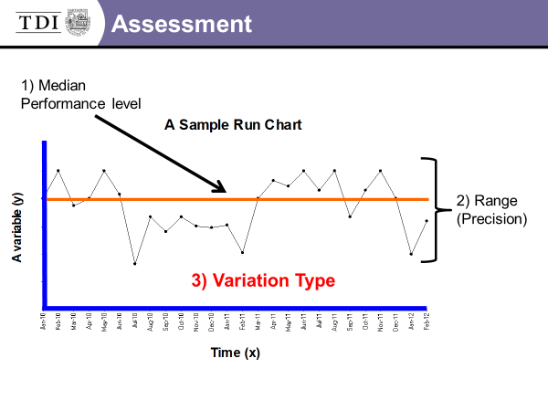
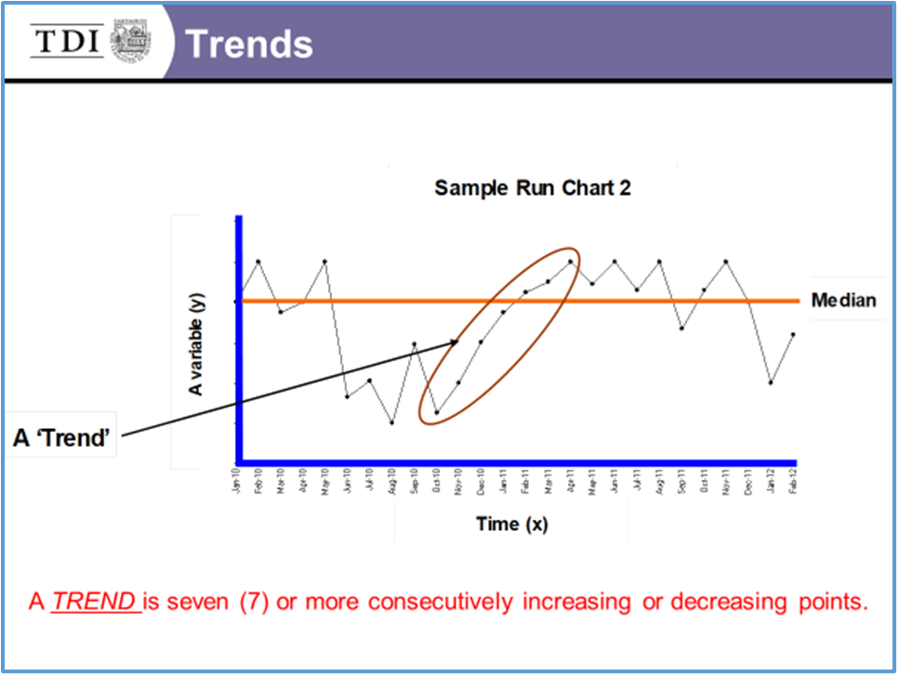
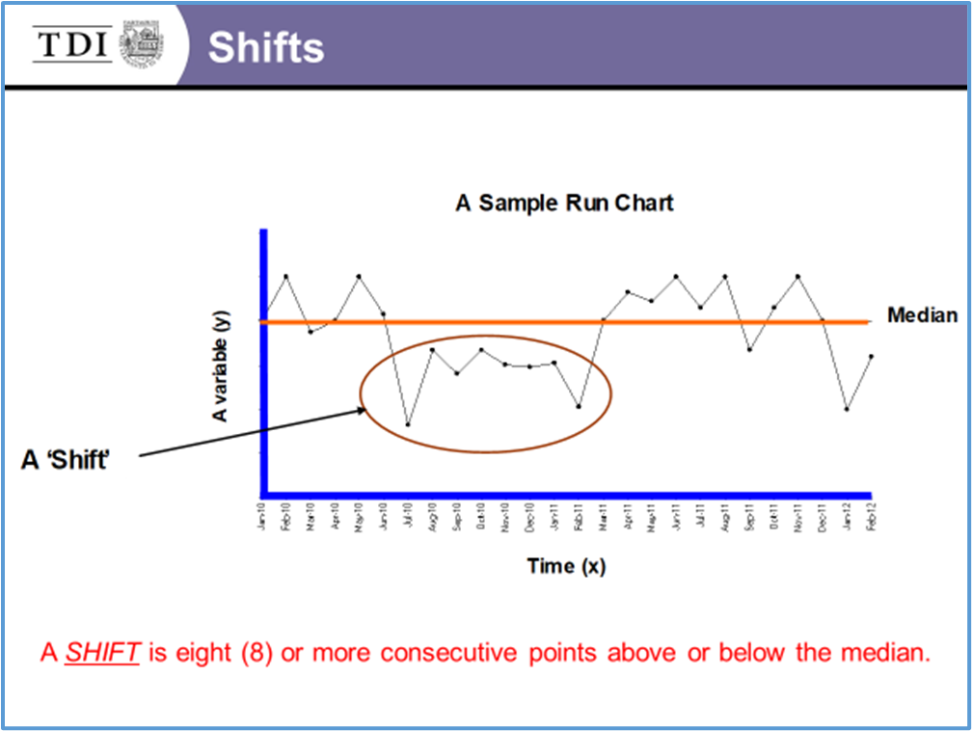
Part III: Improvement Measurement
Types of Measurement
Study of Variation
Using Variation to Inform Improvement
Run Charts
Run Chart Practice!
CHRONIC HEALTH IMPROVEMENT RESEARCH PROGRAM

Slide 27
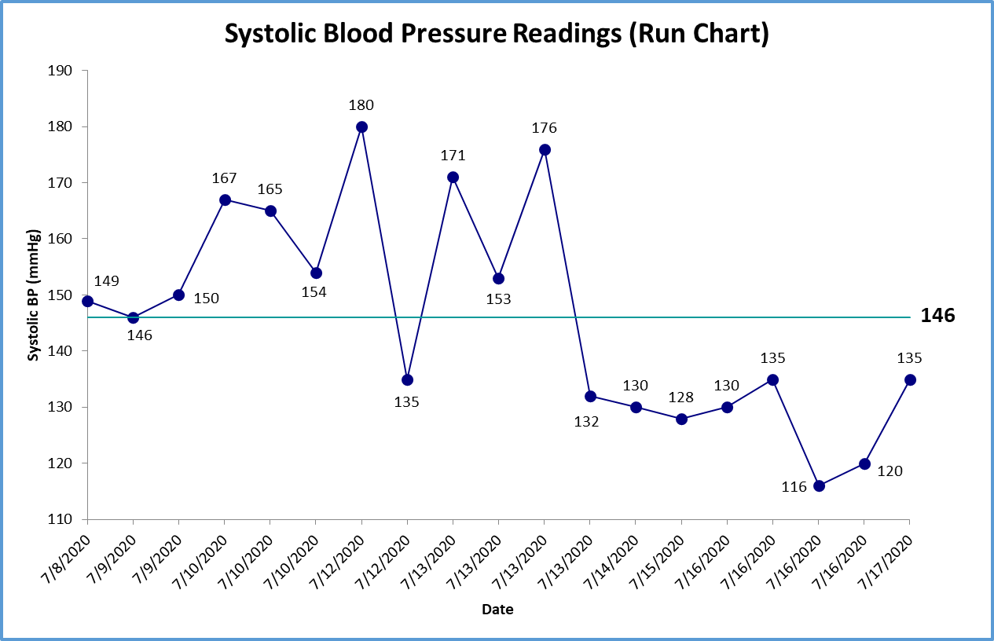
Part III: Improvement Measurement
Types of Measurement
Study of Variation
Using Variation to Inform Improvement
Run Charts
Run Chart Practice!
Poll Questions
What is the median performance level?
What is the precision?
How many SHIFTS are there?
How many TRENDS are there?
What type of variation is present?
CHRONIC HEALTH IMPROVEMENT RESEARCH PROGRAM

Slide 28
Summary
Improvement Passport
Improvement Toolbox
Improvement Measurement
CHRONIC HEALTH IMPROVEMENT RESEARCH PROGRAM

Slide 29
Recommended Resources
Toolbox (Worksheets and Templates)
Brief Videos
  Flowcharts Tutorial
  Driver Diagrams (IHI)
  Defining Measures (Dartmouth Institute)
  Data Collection Plan (Dartmouth Institute)
  Intro to Variation and Run Charts (VAQS)
CHRONIC HEALTH IMPROVEMENT RESEARCH PROGRAM

Slide 30
Thank You!
e-mail: brant.j.oliver@dartmouth.edu | Dartmouth profile
Best wishes for success in your improvement work!
CHRONIC HEALTH IMPROVEMENT RESEARCH PROGRAM

