Slide 1
Reducing Hypertension in High-Risk Populations: Empowering Patients to Improve Blood Pressure
Presentation by Dr. James Stewart, DO, MPH,
Cheri Nichols, RN, BSN, FPCNA,
CDC Representative
Moderated by Ayanna V. Buckner, MD, MPH, FACPM
With
Introduction by Angela Mickalide, PhD, MCHES, ACPM Vice President, Programs & Education

Slide 2
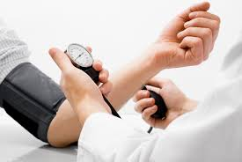
Preventive Medicine: Focusing Upstream
Our Impact
ACPM is a national medical specialty society that represents physicians who work at the unique intersection of clinical care and population health.
ACPM members have both an MD (or DO) and MPH and are trained to care for both individuals and populations.
Notes:
(Slide 2: Focusing Upstream/healthy lifestyle ) ACPM is the professional home for Preventive Medicine Specialists –these are physicians who work at the juncture of medicine and public health.

Slide 3
Where PM Doctors work
Notes:
(Slide 3: Pie chart) They work in many environments
Academia, federal and state governments, the military, county health departments, hospitals and health care systems.
county health departments, hospitals and health care systems.

Slide 4
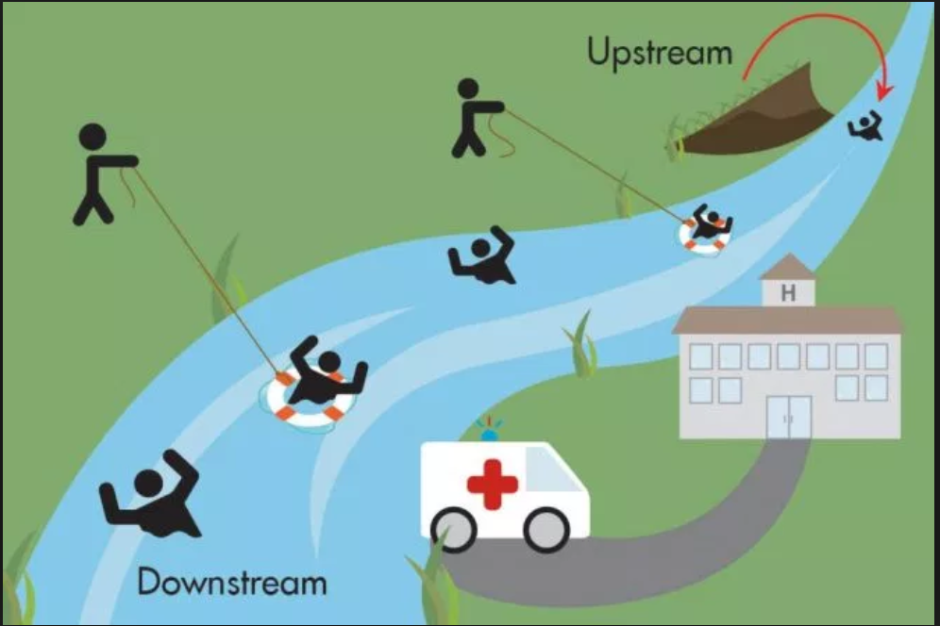
PM’s Agenda: Design Upstream Interventions
Notes:
(Slide 4: Upstream River Slide) Preventive Medicine seeks to be a
Bridge between health care and public health
We look across populations for opportunities to intervene on a large scale and design “upstream” interventions
Reducing hypertension in African-American communities is high on our agenda, has been the subject of past work with women in the WISEWOMAN program, and in our CDC-funded project with African-American men.
We currently have 3 preventive medicine physician faculty members who work with us and health care organizations to implement innovations in identifying and preventing hypertension among African-American men.
Our five demonstration grantees’ work is described on our web site under HTN Initiatives
We wanted to open up the discussions we have been having with our grantees to the community beyond our partners to share ideas
We would like to acknowledge and thank the CDC’s Division of Heart Disease and Stroke Prevention for the funding and technical assistance support to this project.

Slide 5
Objectives
Understand Surgeon General’s Call to Action to Control Hypertension
Recognize benefits of self-measured blood pressure programs
Identify resources to support patients in self-measuring their blood pressure
Discuss an example of a clinic-based blood pressure improvement program that was adapted during the COVID-19 pandemic to help patients begin to monitor and record their blood pressure at home

Slide 6
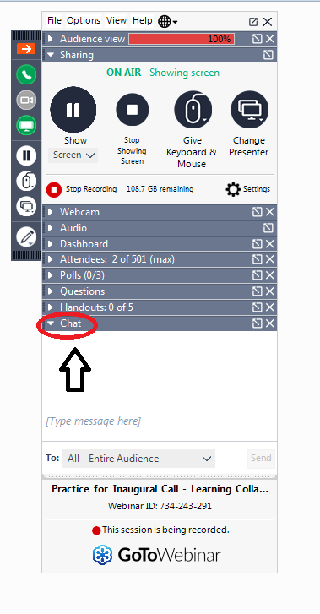
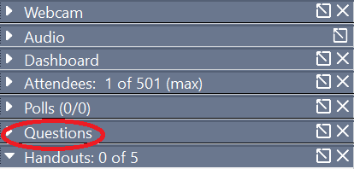
Housekeeping
Please stay in listen-only mode.
The recording will be posted on the ACPM website.
Please type questions in the Q&A box
ACPM will email you a brief feedback survey after the webinar – please respond so that we can improve our offerings!
Notes:
The audience has been placed in listen-only mode
We WILL post a recording of this webinar on the ACPM.org web site
Please type Questions in the Q&A box
Of course, we want to know what you thought and how we can do better, so please fill out the survey you will receive after the webinar.

Slide 7
Surgeon General’s Call to Action to Control Hypertension
Rebekah Buckley, MPH, CRT, AE-C
Acting Branch Chief
Program Development and Services Branch
Division for Heart Disease and Stroke Prevention
Centers for Disease Control and Prevention
Michael L. Sells, PhD, MS, CHES
Project Officer
Advancing Population Health Team
Division for Heart Disease and Stroke Prevention
Centers for Disease Control and Prevention

Slide 8
Reducing Hypertension in High-Risk Populations:
Empowering Patients to Improve Their Blood Pressure
Cheri Nichols, RN, BSN James Stewart, DO, MPH
For the American College of Preventive Medicine Hypertension Learning Collaborative
November 10, 2020

Slide 9
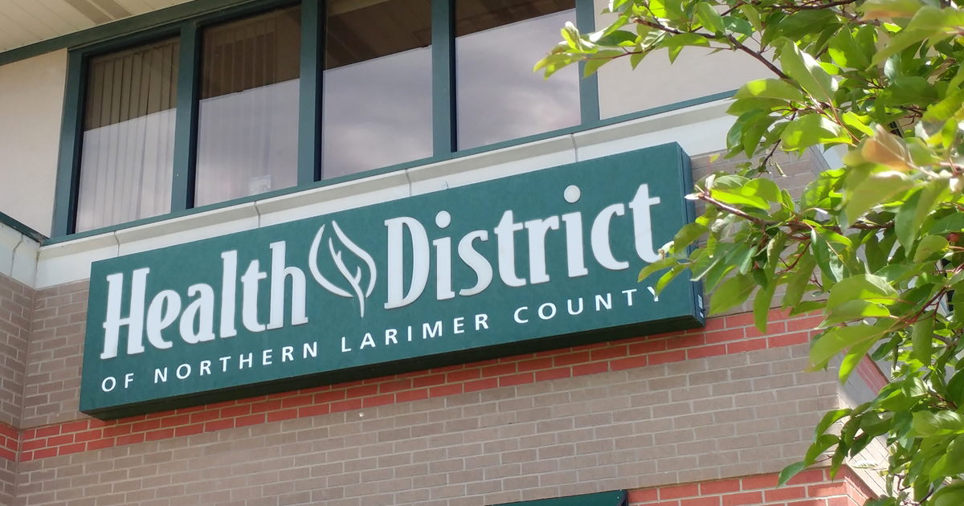

Slide 10
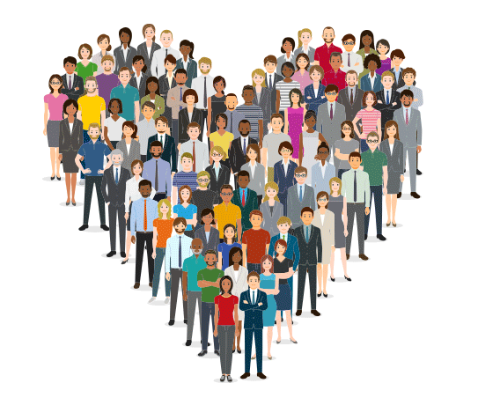
Mission:
To enhance the health of our community

Slide 11
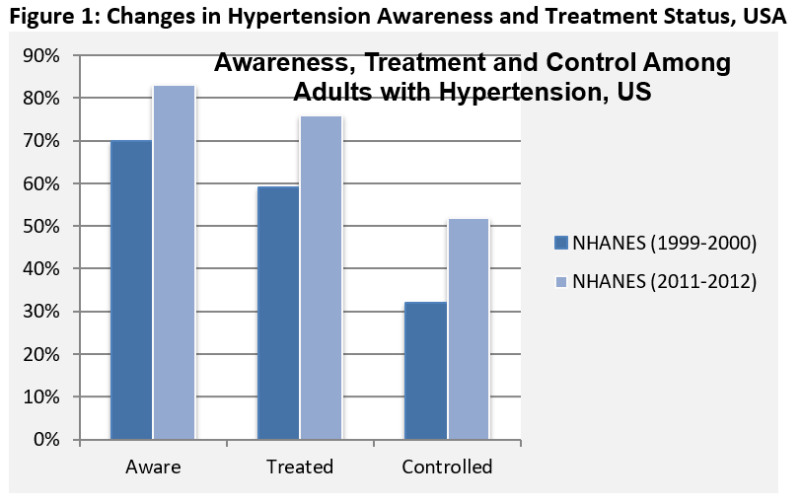

Slide 13
Health District Improving Blood Pressure Program
Logic Model (program intervention hypothesis)
IF
THEN
People with hypertension are aware of the service
Patients ↑ knowledge of
BP and how to ↓risk
People with hypertension enroll
Pts set goals, change behaviors to control BP
We provide
Intervention
Pts reduce risk of CVD, live longer and healthier

Slide 14
Only 24% with hypertension are controlled
Source: Million Hearts 2020 https://millionhearts.hhs.gov

Slide 15
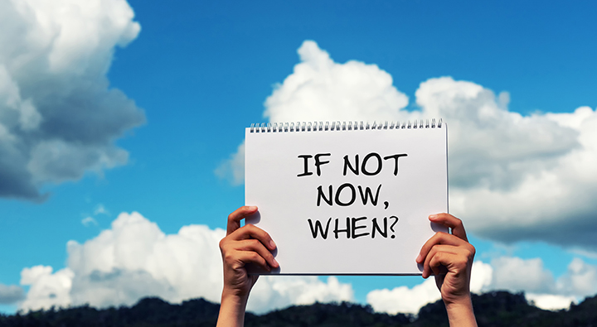
“We need to develop a culture of caring about blood pressure.”

Slide 16
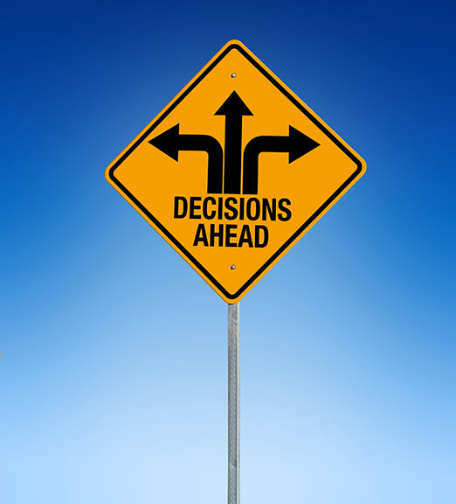
Blood pressure control is entirely in the hands of the individual. It’s an ongoing long haul.

Slide 17
Improving Blood Pressure Program Goals
Teach about blood pressure

Slide 18
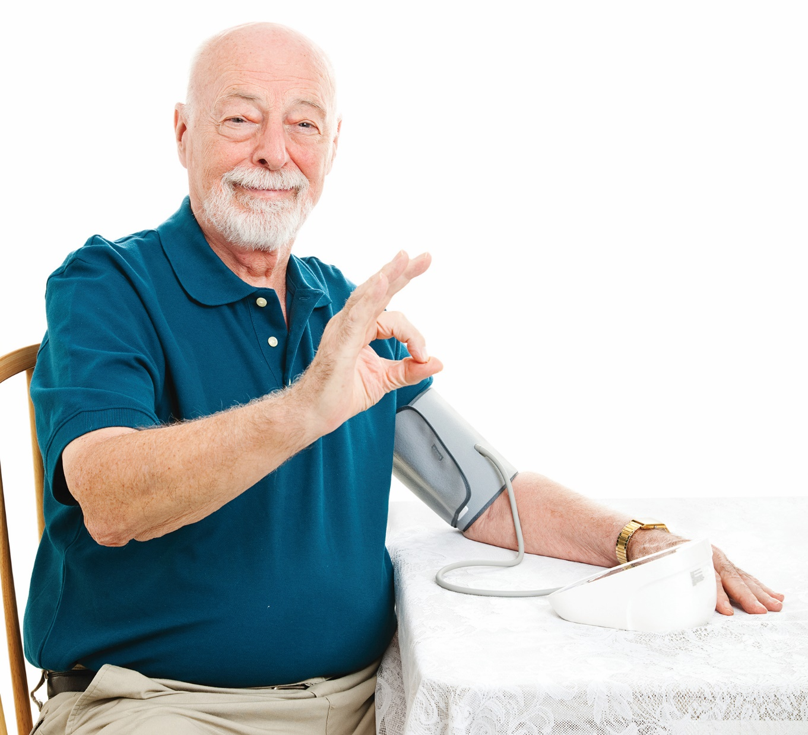
Teach self measured blood pressure

Slide 19
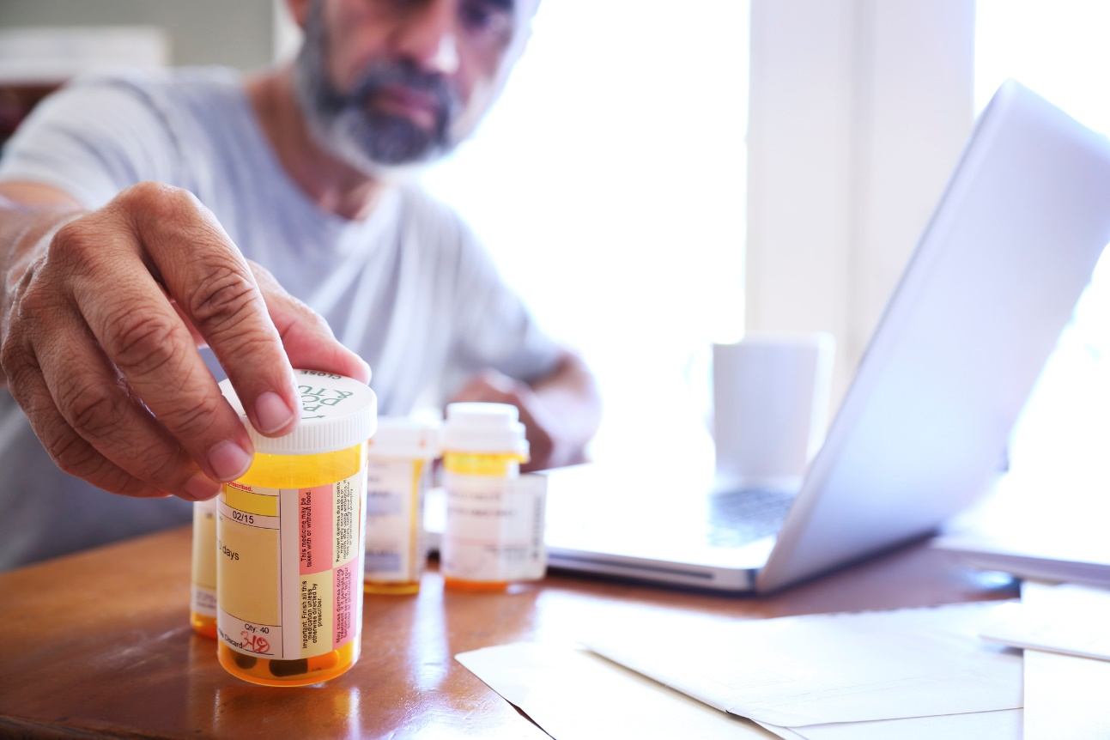
Address
Medication Adherence
Address medication adherence

Slide 20
Promote communication with provider

Slide 21
Address lifestyle
behaviors

Slide 22
Intervention
Support
and
Reinforce

Slide 23
One-on-0ne
with a nurse

Slide 24
Local taxes
at work

Slide 25
BP cuff
loan program

Slide 26
An ordinary, common story
The buddy system
in action

Slide 27
Client Challenges
Hypertension
is
silent

Slide 28
Clients want to
learn and understand

Slide 29
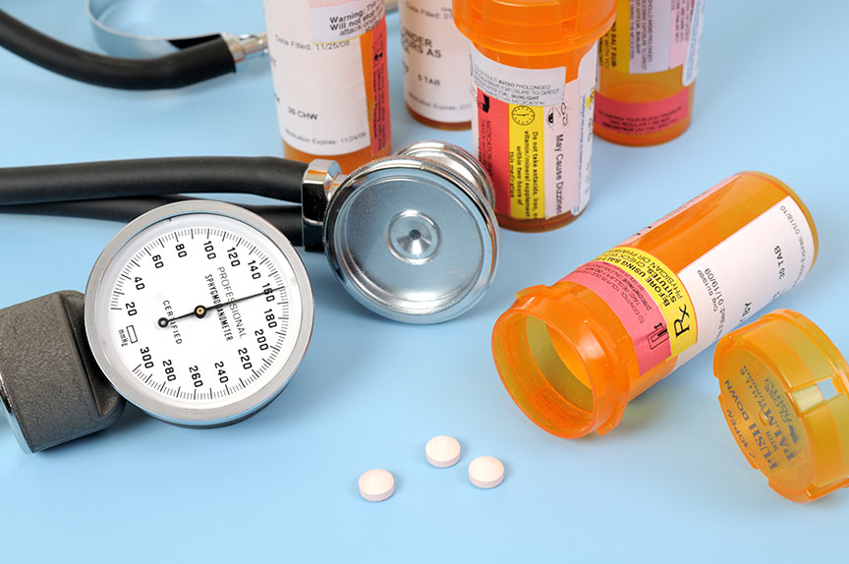
Medication
adherence

Slide 30
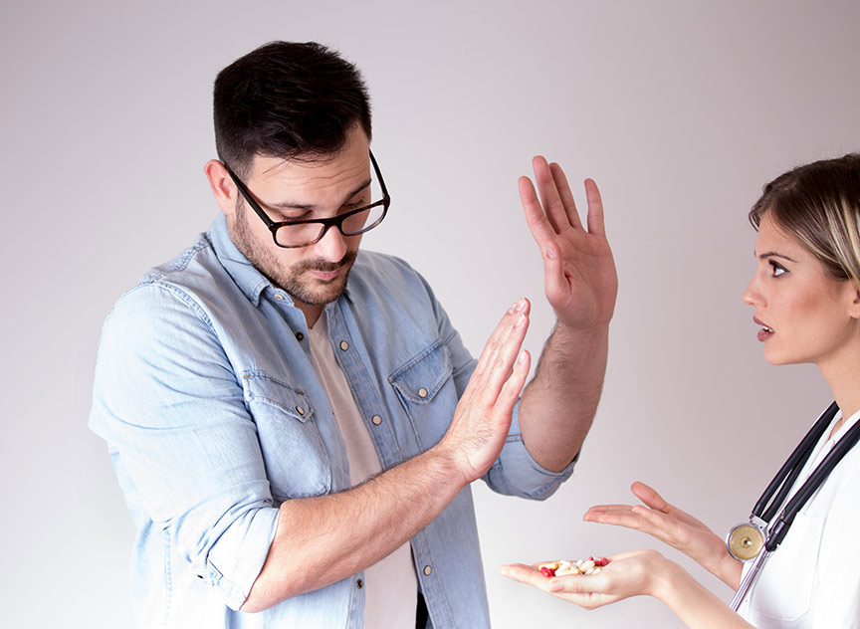
Communication with provider

Slide 31
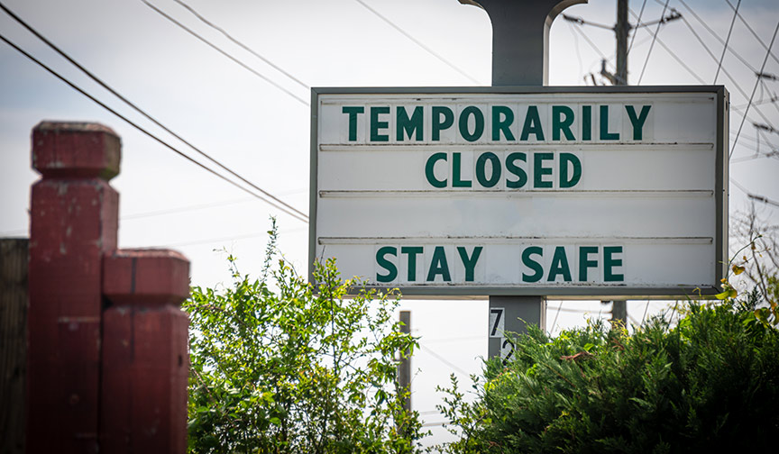

Slide 32
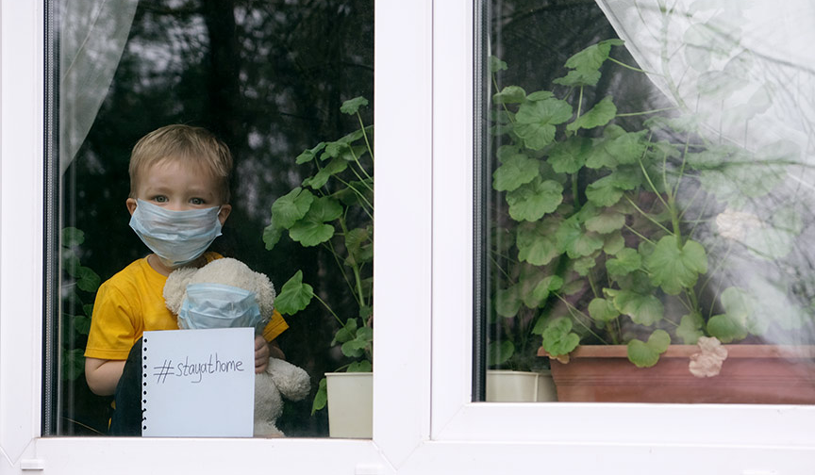

Slide 33
Adapting the program

Slide 34
Getting the message out

Slide 35
A new way to connect

Slide 36
Challenges to be addressed
A client’s story:
His tough road

Slide 37
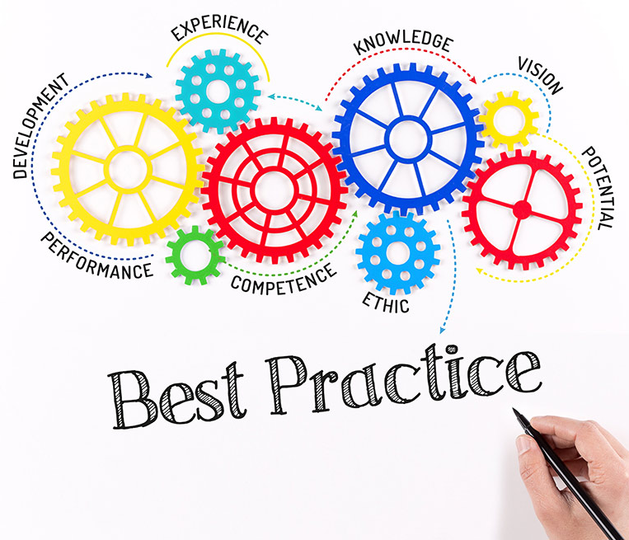
EVALUATE!

Slide 38
Follow-up with clients
One- and three-month follow-up calls to evaluate status of SMBP practices
SMBP average
Reinforce success
Identify and address barriers

Slide 39
Blood Pressure Improvement
Systolic pressure decreased 13.7 mmHg
Diastolic pressure decreased 5.9 mmHg

Slide 40
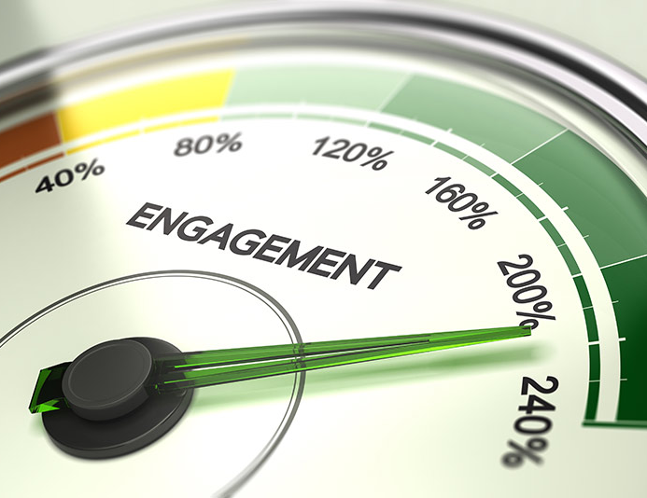
Practicing SMBP?
87% completed program, attending 3 or more sessions
Of completers, 100% reported learning SMBP and sharing their record with their provider

Slide 41
What does the future look like?

Slide 44
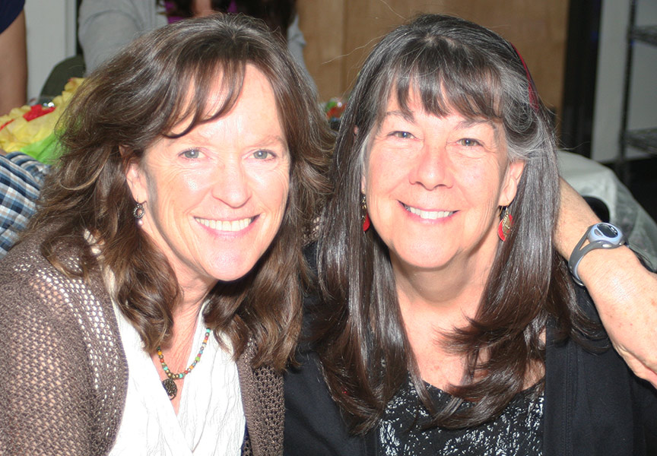
Julie
Cheri
A nurse partnership
(pre-pandemic photo)

Slide 45
Challenge:
Develop a culture of caring
about blood pressure

Slide 46
18th Annual Meeting of the National Forum:
“We must humanize our messaging.”

Slide 47
EVERY HEART MATTERS!

Slide 48
Questions?
Slides and handouts will be emailed to all registrants and
posted on ACPM.org/initiatives/Hypertension
Please enter your questions in the Q&A box

Slide 49
Reducing Hypertension Among African-Americans
Thank You!
www.acpm.org/initiatives/hypertension

